Slide 1
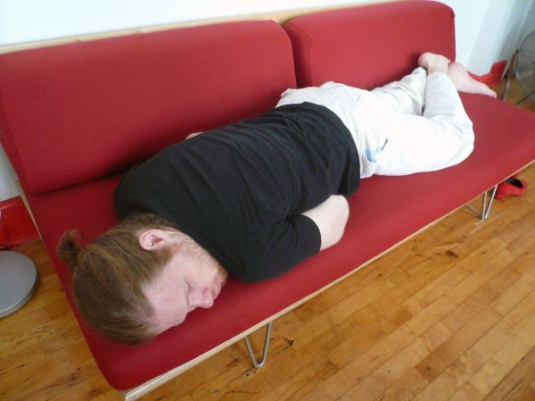
Quest: Escape Room
Project 1
Project team:
Ana Melissa
Johannes
Nimrod
Bartek

Slide 2
Already provided
Game structure
4 Rooms: Game Room, Bedroom 1, Bedroom 2, Living Room
Items: Couch, Piano, Queen Bed, Double Bed, Dresser, Dining Table
Doors: A, B, C, D
Code structure
Initialization: assigning initial values to rooms, items and defining relationships between them
Functions
Executions elements: start the game, go to next room and
Functions
start_game
Play_room
Explore
Examine
get _next_room_of_door
Linebreak

Slide 3
Added to the game
New functions
Image upload function (URL link to images and Gifs saved in GitHub)
Timer function: function to store the starting time in variable and at the end comparing the starting with the end time
Console-cleaning function for a fresh start upon entering a new room
Extra features to leverage UX
Visual attributes to make the game more tangible, exciting and playful (e.g. gif, static images)
Style features to make the copy more readable (e.g. colors, casing, line breaks)
Lowercase the inputs it more readable
Timer to add a feeling of tension ,urgency, challenge. It also allows to track game stats and make best lists.

Slide 4
Main tech challenges
Most important technical challenge we have faced during the process was understanding the code in its entity. With different structures that intertwine with each other in ways we have not yet encountered. It required from us a great deal of time to fully figure out the relationships between all functions and the data structure involved in the process.
To master this challenge we relayed on documentation provided in the student portal, material studied in the class, online research and most of all meticulously studying the code line by line.
Notes:
Could be changed from free text into bullet points if needed for simplifying the slide and making it more pleasant

Slide 5
Our biggest mistake
Rushing into coding with no clear GitHub workflow occasionally led to team members overwriting crucial parts of code.
This highlights the necessity of a well-structured GitHub workflow for seamless collaboration and effective project execution.

Slide 6
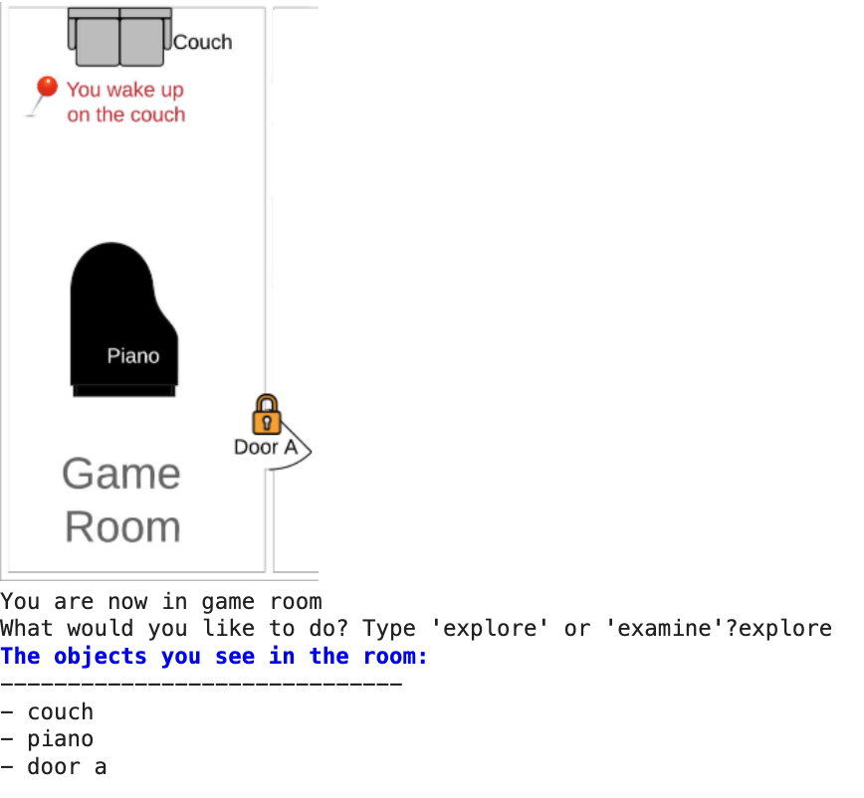
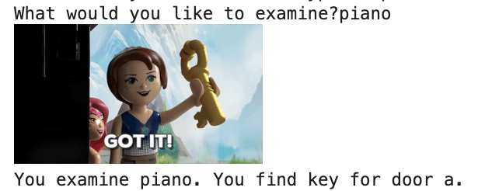
Demo
Click on me to dive into the game!

Slide 7
THANK YOU
Work by Johannes, Nimrod, Ana Melissa, Bartek

